Slide 1
Java 11 & 17 Features

Slide 2
Java 11 Features
Running Java Files
New String Methods
Nest Based Access Control
New File Methods
Collection to an Array
HTTP Client
Local-Variable Syntax for Lambda
Dynamic Class-File Constants
Improved Aarch64 Intrinsics
Epsilon Garbage Collector
Java Flight Recorder

Slide 3
Running Java Files
Execute Java File Without Compilation
From Java 11, Java provides flexibility to run Java code without compilation. It means we can execute Java code in a single step.
Before Java 11, if we execute Java file then first, we need to compile the code and then run the code. This whole process requires two major steps:
Compile Java code
Run Java code
To compile the code, we use javac MyFirstProgram.java command. and
To run this file, we use java MyFirstProgram command in the terminal (cmd in windows).
But if we are working with Java 11 then we don't need to follow these two steps. Just use single command java java_file.java and it will execute the file by producing the desired result.
Note: This feature is applicable if we have a single file of source code. It means all the code is in a single file, with no external dependency.
Notes:
For Reference https://www.studytonight.com/java-examples/java-11-new-features

Slide 4
New String Methods
isBlank() - this method is used to check whether a string is blank or not. Empty strings and strings with just whitespace are considered blank.
lines() - this method splits a string using line terminators and returns a stream.
repeat() - this method is used to duplicate or repeat a string.
strip(), stripLeading(), stripTrailing() - These methods are used to remove whitespace from the strings. They are very similar to the existing trim() method, but provide Unicode support.
Notes:
For Reference https://www.studytonight.com/java-examples/java-11-new-features

Slide 5
Nest Based Access Control
Previous Java versions allowed access of private members to nested classes(nestmates), but we cannot use them with the Reflection API. Java 11 no longer uses bridge methods and provides the getNestHost(), getNestMembers(), and isNestmatOf() methods for the Reflection API.
Notes:
For Reference https://www.studytonight.com/java-examples/java-11-new-features

Slide 6
New File Methods
Java 11 makes it a lot easier to read and write strings.
The readString() and writeString() static methods are added to the Files class for this purpose.
Notes:
For Reference https://www.studytonight.com/java-examples/java-11-new-features

Slide 7
Collection to an Array
The new default toArray() method is used to easily convert a collection to an array of the correct type.
Notes:
For Reference https://www.studytonight.com/java-examples/java-11-new-features

Slide 8
The not() Method
A static not() method has been added to the Predicate interface in Java 11.
As the name suggests, this method is used to negate a Predicate. The not() method can also be used with method references.
Notes:
For Reference https://www.studytonight.com/java-examples/java-11-new-features
Let's use this method to create two predicates that perform opposite tasks.

Slide 9
HTTP Client
The HTTP Client API was first introduced in Java 9 and was updated in Java 10.
It is offered as a standard feature in Java 11 version.
The new API has better performance and is compatible with both HTTP/1.1 and HTTP/2.
The API also provides support for WebSockets.
Notes:
For Reference https://www.studytonight.com/java-examples/java-11-new-features

Slide 10
Local-Variable Syntax for Lambda
Java 11 adds the support for Local-Variable syntax for lambda expressions.
Lambdas can infer the type, but using the var keyword allows us to use annotations like @NotNull or @Nullable with the parameters.
(@NotNull var str) -> "$" + str
Notes:
For Reference https://www.studytonight.com/java-examples/java-11-new-features

Slide 11
Dynamic Class-File Constants
In Java 11, the Java Class-File format supports a new constant pool form called the CONSTANT_Dynamic.
This will delegate creation to a bootstrap method.
This was introduced to reduce the cost of creating new forms of materializable class-file constants by creating a single new constant-pool form that will be parameterized with appropriate user-defined behavior.
This feature greatly enhances the performance.
Notes:
For Reference https://www.studytonight.com/java-examples/java-11-new-features

Slide 12
Improved Aarch64 Intrinsics
An Intrinsic is a function that is handled in some special way by the compiler.
They take advantage of the CPU architecture-specific assembly code to improve performance.
Java 11 improved and optimized the existing string and array intrinsic on AArch64(or ARM64) processors.
Java 11 also added new intrinsics for sin, cos, and log methods of the java.lang.Math.
Notes:
For Reference https://www.studytonight.com/java-examples/java-11-new-features

Slide 13
Epsilon Garbage Collector
Java 11 introduced a no-operations(No-Op) garbage collector called Epsilon. This is an experimental feature.
It is called a No-Op garbage collector because it will allocate memory but will never collect any garbage.
We can use it for simulating Out-Of-Memory errors.
The following are some of its use cases.
Performance testing
Memory pressure testing
VM interface testing and
Extremely short-lived jobs
Last-drop latency and throughput improvements
Use the following command to enable the Epsilon GC.
-XX:+UnlockExperimentalVMOptions -XX:+UseEpsilonGC
Notes:
For Reference https://www.studytonight.com/java-examples/java-11-new-features

Slide 14
Java Flight Recorder
Java Flight Recorder(JFR in short) is used to gather profiling data for an application.
It used to be available only for commercial uses, but it is now open-source under OpenJDK 11.
We can use it for production applications, as its overhead is minimal(below 1%).
It records the data in a JFR file, and we can use the JDK Mission Control tool to analyze the collected information.
Use the following command to start a 180 seconds JFR recording and store the data in the demo.jfr file.
-XX:StartFlightRecording=duration=180s,settings=profile,filename=demo.jfr
Notes:
For Reference https://www.studytonight.com/java-examples/java-11-new-features

Slide 15
Java 17 Features
Sealed Classes
Pattern Matching in Switch
Record
String Text Blocks

Slide 16
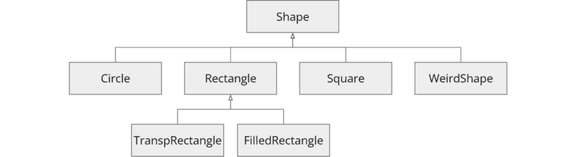
Sealed Classes
The big innovation in Java 17 (besides long-term support) is sealed classes (and interfaces).
Starting Point: Example Class Hierarchy
Source code of the example
public class Shape { ... }
public class Circle extends Shape { ... }
public class Rectangle extends Shape { ... }
public class Square extends Shape { ... }
public class WeirdShape extends Shape { ... }
public class TranspRectangle extends Rectangle { ... }
public class FilledRectangle extends Rectangle { ... }

Slide 17
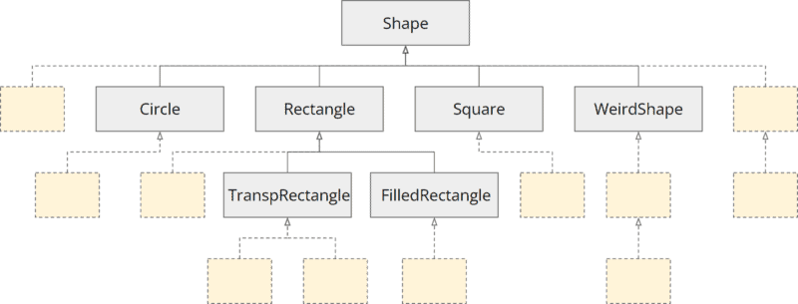
Sealed Classes
Usually, every developer can extend this class hierarchy at any place.
An extended structure could look like this (here colored the added classes light yellow):
Sealed classes example - extension possibilities without sealing
Notes:
Now, we may want to restrict the extension of our class hierarchy. For example, we might want to specify that developers may only extend the WeirdShape class.
Why would we want to do that, and how can we do it?

Slide 18
Sealed Classes
Why Restrict the Extensibility of a Class Hierarchy?
There may be several reasons why we want to restrict the free extensibility of our class hierarchy:
We want to protect the internal state of a class or a hierarchy of classes and not have it manipulated inconsistently by a child class.
We want to protect internal objects whose thread safety is guaranteed by our class or class hierarchy from being published so that foreign code cannot compromise thread safety.
We want to ensure that the Liskov substitution principle (LSP) is not violated. That is, we don't want a developer to implement a derived class that breaks the API contract of the parent class.
Notes:
Now that we know the reasons for constraining a class hierarchy, we move on to the next question: How can we do that?

Slide 19
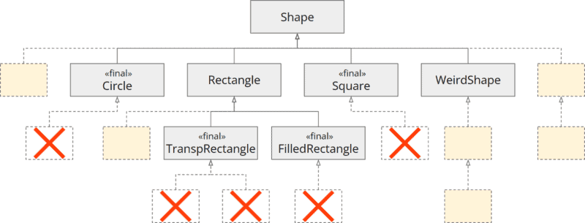
Sealing the Class Hierarchy – Step by Step
Restricting the Class Hierarchy with “final”
By marking classes as "final", we can prevent their extension in general.
A second option would be to mark a class as package-private to permit only subclasses within the same package.
However, this would have the consequence that the superclass would no longer be visible outside the package, which is undesirable in most cases.
Let's try to use "final" in our example.
We mark the classes Circle, TranspRectangle, FilledRectangle, and Square as final (remember: WeirdShape should remain the only extendable class).
This limits the extensibility of our class hierarchy, as shown in the following class diagram:

Slide 20
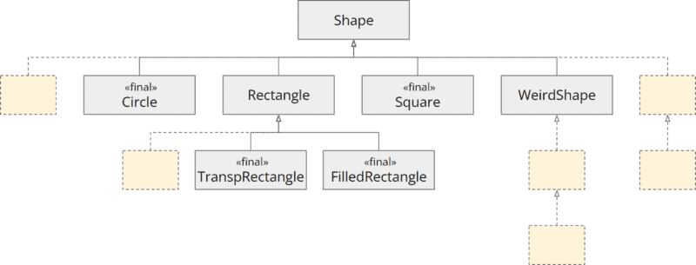
Sealing the Class Hierarchy – Step by Step
To improve clarity, here is the removed the crossed-out boxes below the final classes in the following graphic:
Restricting the class hierarchy with "final"
Notes:
This means we are on the right track, but we are still far from our goal. What now? Obviously, we can't make Shape and Rectangle final because other classes should extend them.
This is where sealed classes come in...

Slide 21
Sealing the Class Hierarchy with "sealed" and "permits"
Using "sealed types", we can implement what is called a "sealed class hierarchy".
It works as follows:
We mark the class whose subclasses we want to restrict with the sealed keyword.
Using the keyword permits, we list the allowed subclasses.
We extend the code of the Shape and Rectangle classes as follows:
public sealed class Shape permits Circle, Square, Rectangle, WeirdShape { ... }
public sealed class Rectangle extends Shape permits TranspRectangle, FilledRectangle { ... }
Notes:
With this code, we state the following:
The Shape class may only be extended by the Circle, Square, Rectangle and WeirdShape classes.
The Rectangle class may only be extended by the TranspRectangle, and FilledRectangle classes.

Slide 22
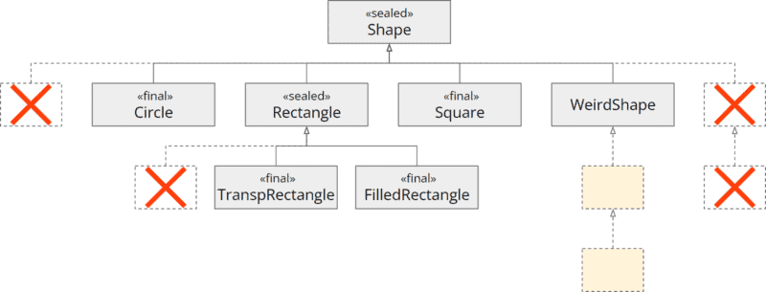
Sealed Class
The following class diagram shows the constraints added by sealed and permits:
Restricting the class hierarchy with "sealed" and "permits"

Slide 23
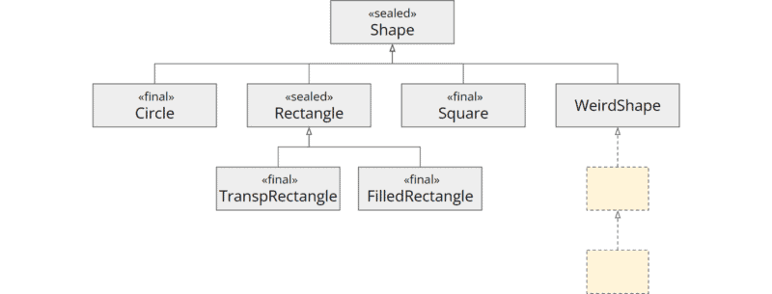
Sealed Class
For the sake of clarity, once more without the crossed-out classes:
Restricting the class hierarchy with "sealed" and "permits"
Notes:
It looks like we have reached our goal. But one step is still missing…

Slide 24
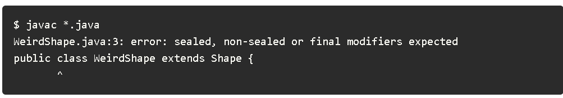
Opening the Sealed Class Hierarchy with "non-sealed"
With the changes made so far, our code looks like this:
public sealed class Shape permits Circle, Square, Rectangle, WeirdShape { ... }
public final class Circle extends Shape { ... }
public sealed class Rectangle extends Shape permits TranspRectangle, FilledRectangle { ... }
public final class Square extends Shape { ... }
public class WeirdShape extends Shape { ... }
public final class TranspRectangle extends Rectangle { ... }
public final class FilledRectangle extends Rectangle { ... }
When we try to compile this code, we get the following error message:

Slide 25
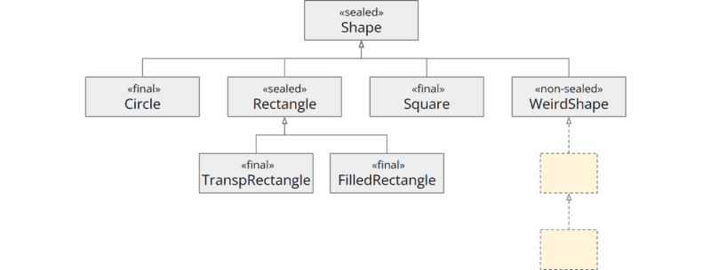
Opening the Sealed Class Hierarchy with "non-sealed"
For preventing accidental openings of the sealed class hierarchy, all classes must be marked sealed, non-sealed, or final.
Our WeirdShape class should be extensible, i.e., the sealing should be opened at this class. Therefore we have to mark this class as non-sealed:
public non-sealed class WeirdShape extends Shape { ... }

Slide 26
Particularities
There are some particularities to keep in mind when using sealed class hierarchies.
Sealing within a "Compilation Unit“
Local Classes
instanceof Tests with Sealed Classes

Slide 27
Pattern Matching in Switch
In Java 17,Pattern Matching for switch has been introduced as a preview language feature, which allows case labels with patterns rather than just constants.
Here is an example showing how you can match on type patterns:
public static String typedPatternMatching(Object o) {
return switch(o) {
case null -> "I am null";
case String s -> "I am a String. My value is " + s;
case Integer i -> "I am an int. My value is " + i;
default -> "I am of an unknown type. My value is " + o.toString();
};
}

Slide 28
Pattern Matching in Switch
We can also use a guarded pattern in order to refine a pattern so that it is only matched on certain conditions, for example:
public static String guardedPattern(Collection<String> coll) {
return switch(coll) {
case List list && (list.size() > 10) ->
"I am a big List. My size is " + list.size();
case List list ->
"I am a small List. My size is " + list.size();
default ->
"Unsupported collection: " + coll.getClass();
};
}

Slide 29
Pattern Matching in Switch
If we have a Sealed Class (made a permanent language feature in Java 17), the compiler can verify if the switch statement is complete so no default label is needed.
For example:
sealed interface Vehicle permits Car, Truck, Motorcycle {}
final class Car implements Vehicle {}
final class Truck implements Vehicle {}
final class Motorcycle implements Vehicle {}
public static String sealedClass(Vehicle v) {
return switch(v) {
case Car c -> "I am a car";
case Truck t -> "I am a truck";
case Motorcycle m -> "I am a motorcycle";
};
}

Slide 30
Record
Java record is a type of class whose sole purpose is to drive programming with immutable data.
Let’s look at a simple example
public record Data( int x, int y)
So here we have created a record with header x and y.
The x and y here are referred to as components of a record. Now, when we create a record, we get the following:
Final fields based on the record components.
Canonical constructor. (constructor based on the record components)
An accessor method that is the same as the field’s name, an equals method, and a hashcode method out of the box already implemented for you.
A toString method implementation that prints the record components along with the component names.

Slide 31
Record
So an equivalent class would be like this:
public class Data {
final private int x;
final private int y;
public Data( int x, int y){
this.x = x;
this.y = y;
}
public boolean equals(Object o) { ... }
public int hashCode() { ... }
public String toString() { ... }
}

Slide 32
Record Initialization
When we declare a normal class without any constructor the compiler provides a default constructor with no arguments.
In the case of records, an implicit canonical constructor based on the record components is provided.
We can explicitly create a canonical constructor by yourself by doing things like e.g validations but there is a more concise way to do that.
public record Data(int x, int y) {
public Data {
if (x >y) {
throw new IllegalArgumentException();
}
x+=100;
y+=100;
}
}
Notes:
In the above record, I have performed a simple validation and I have added a further 100 to each once it was passed. This way of defining a compact constructor means I am still working with header variables and the actual assignment to the instance variables happens at the end. The above code would be equivalent to the following :

Slide 33
Record Initialization
The previous code would be equivalent to the following :
public class Data {
final private int x;
final private int y;
public Data( int x, int y){
if (x >y) {
throw new IllegalArgumentException();
}
x+=100;
y+=100;
this.x = x;
this.y = y;
}
}
Notes:
In the above record, I have performed a simple validation and I have added a further 100 to each once it was passed. This way of defining a compact constructor means I am still working with header variables and the actual assignment to the instance variables happens at the end.

Slide 34
Record Classes
Record Classes Cannot Be Extended Neither Support Extension
Record classes do not support extensions.
We simply cannot extend it with any other class, not even a record class.
The only implicit superclass it has is java.lang.Record because defining record class explicitly by using extends only leads to compilation errors.
The record classes are implicitly final. They cannot be declared abstract to allow further extensions. This means you cannot have any sub-records of a record.

Slide 35
Record -Implementing Interfaces
Record classes allow you to implement interfaces.
We can implement any interface we want whether it’s a single interface or multiple interfaces.
public record Data( int x, int y) implements Runnable, Serializable

Slide 36
Record
Cannot Define our Own Instance Variables
When we define the header, it represents the state of our record class.
This means we cannot have any other instance variable inside the record.
The only instance variable that would be created is the ones provided in the header component. However, we can have static variables inside records that can be accessed the same way as classes by using the record class name.

Slide 37
Record
Defining Your Own Methods
We can define our own methods that we would want to use inside a record, including our own version of the accessor, equals, or even hashcode methods. Yet, we need to ensure that we do not make any changes that would result in breaking what immutability means.
We can also define the static methods and static initializers similar to how we have it in class declarations.

Slide 38
Record
Applying Annotations
Now, the important thing about applying annotations is that when defining the annotations, we can apply them to the record components.
Annotation applies to the scopes depending on the target scope of your annotation.
Let’s look at the different cases.
If the annotation is targeted to fields, then it’s applied to the private instance variable.
In the case of the target is a method, it would be applied to the accessor method.
If the annotation refers to the header arguments, then they would refer to the parameters of the canonical constructor arguments.
Notes:
For instance, if you apply a @NotNul lannotation which actually applies to the field, method, and constructor then it would get applied to the instance variable, the accessor method, and the constructor.
However, in the case where you explicitly define an annotation on your custom-defined accessor method or canonical constructor, the annotations on these would only be applied to the corresponding method or constructor.

Slide 39
Record – Local Records
We can see records have a very useful place when we just want to temporarily hold immutable data inside a function.
For example
public List<Person> sortPeopleByAge(List<Person> people) {
record Data(Person person, int age){};
return people.stream()
.map(person -> new Data(person, computeAge(person)))
.sorted((d1, d2) -> Double.compare(d2.age(), d1.age()))
.map(Data::person)
.collect(toList());
}
Notes:
As you can see, I have created a local record class without any ceremony that you might require while creating a class. I have used it to store the intermediate result and then used it for comparison to have a more concise and readable code.

Slide 40
Text Blocks
Multiline Strings in Java
Before Java 15, when we wanted to define a multi-line string in Java, it usually looked like this:
String sql =
" SELECT id, firstName, lastName\n"
+ " FROM Employee\n"
+ " WHERE departmentId = \"IT\"\n"
+ "ORDER BY lastName, firstName";
String html =
"<html>\n"
+ " <body>\n"
+ " <p>Hello World!</p>\n"
+ " </body>\n"
+ "</html>";
Notes:
We had to replace line breaks and quotes with escape sequences (\n and \"). And to split the string into several lines in a somewhat readable way, we had to divide it and concatenate it again with +. That was not too bad (because the compiler made a single string out of it again), but it was not pleasant either.

Slide 41
Text Block Notation
Starting with Java 15, we can notate multiline strings as "text blocks":
String sql = """
SELECT id, firstName, lastName
FROM Employee
WHERE departmentId = "IT"
ORDER BY lastName, firstName""";
String html = """
<html>
<body>
<p>Hello World!</p>
</body>
</html>""";
The text block starts and ends with three quotation marks each. The following rules apply:
The starting quotes must be followed by a line break (which does not become part of the string).
If there is a line break before the ending quotes, this line break will be part of the string.
You do not need to escape single or double quotes within the text block, but you may (though SCA tools such as SonarLint recommend not doing so).
If you want to write more than two quotation marks, you have to escape every third of them.

Slide 42
Text Blocks
One of the first questions developers ask themselves is:
How Far Must the Text Block Be Indented?
The answer is: it doesn't matter.
The text block starts at the character furthest to the left (in the first example above, at the "O" of "ORDER BY"; and in the second example, at the angle brackets in the first and last line).
The following three notations all lead to the same result:
String sql1 = """
SELECT id, firstName, lastName
FROM Employee
WHERE departmentId = "IT"
ORDER BY lastName, firstName""";
String sql2 = """
SELECT id, firstName, lastName
FROM Employee
WHERE departmentId = "IT"
ORDER BY lastName, firstName""";
String sql3 = """
SELECT id, firstName, lastName
FROM Employee
WHERE departmentId = "IT"
ORDER BY lastName, firstName""";
Notes:
All three strings have the following content – regardless of the indentation in the source code:
SELECT id, firstName, lastName FROM Employee WHERE departmentId = "IT" ORDER BY lastName, firstName

Slide 43
Text Blocks
Escape Sequences in Text Blocks
Text blocks have the advantage that the escape sequences most commonly used in strings, namely \" for quotes and \n for a line break, are no longer needed.
Instead, there are two new escape sequences:
Escape Sequence: Backslash at the End of the Line
Escape Sequence: \s
See example code for details

